Slide 1
Density Seems to Matter The Impact of COVID-19 Pandemic on Housing Prices on Oahu Island, Hawaii
Patricia Yu, Ph.D.
Assistant Professor of Economics
University of Hawai'i West O'ahu
Jeremy R. Groves, Ph.D., ACUE
Associate Professor of Economics
Northern Illinois University
Presentation for the Midwest Economics Association Conference March, 24, 2024

Slide 2
Key Questions
How did the government response to the Covid-19 Pandemic impact the value of residential property?
Interest rate changes
“Free” money
How did any change in housing consumer preferences in response to the Covid-19 Pandemic impact the value of residential property?
Working from home
Having neighbors

Slide 3
Literature Review
Overall results are mixed, primarily due to the small window from which the data is drawn.
No Impact
Delgado & Katafuchi (2020) - Japan
Yoruk, B. K. (2022) – Metro Areas
Zeng & Yi (2022) – Wuhan area
Generally found decreases in volume but no discernable impact on price.
Negative Impact
Del Giudice, et. al. (2020): Italy (4.16%)
Hu, et. al. (2021) – Austrian (0.35 – 1.26%)
Qian, et. al. (2021): Ireland (2.47%)
Francke & Korevaar (2021): Amsterdam and Paris (risk premium ↑)
Liu & Su (2021): (shift by density)
Positive Impact
Kadi, et. al. (2020): Austria (B&B to Rental)
Verma & Husain (2020): Canada
Arcaya, et. al. (2020)
Yang & Zhou (2021): China
Mixed Impact
Li & Zhang (2021): US (population density)
Wang (2021): US Metro (Houston, Santa Clara, Irvine, Des Moines increase; Honolulu decrease)
Gupta, et. al. (2022): US (city vs. suburban)
D’Lima, et. al. (2022): US (population density)
Yang, et. al. (2023): China (low vs. high income housing)

Slide 4
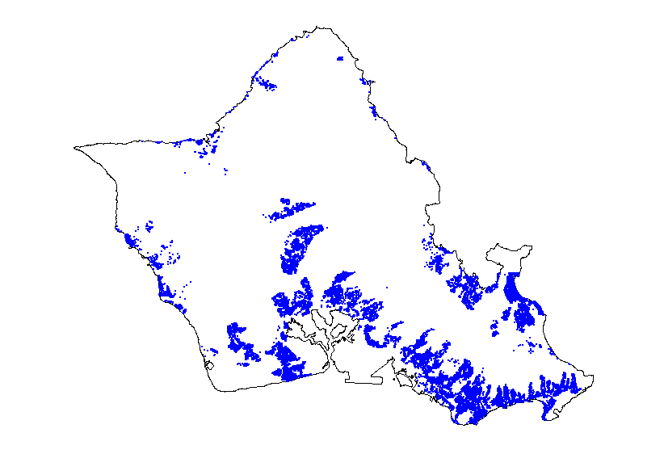
Data
All arms-length transactions from Multiple Listing Service of HiCentral MLS, Ltd. (thank you Honolulu Board of REALTORS®)
Original data held 57,217 transactions for 51,239 unique units.
After cleaning data, we are left with 50,394 observations over 43,057 unique units.
Sold Once | 36,367 units
Sold Twice | 6,075 units
Sold Three Time | 586 units
Sold Four or Five Times | 29 units

Slide 5
Data

Slide 6
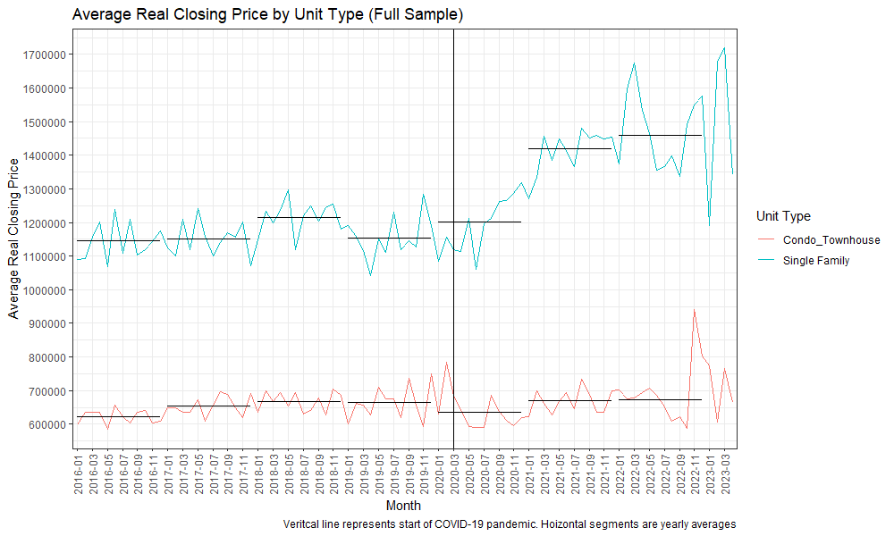
Data

Slide 7
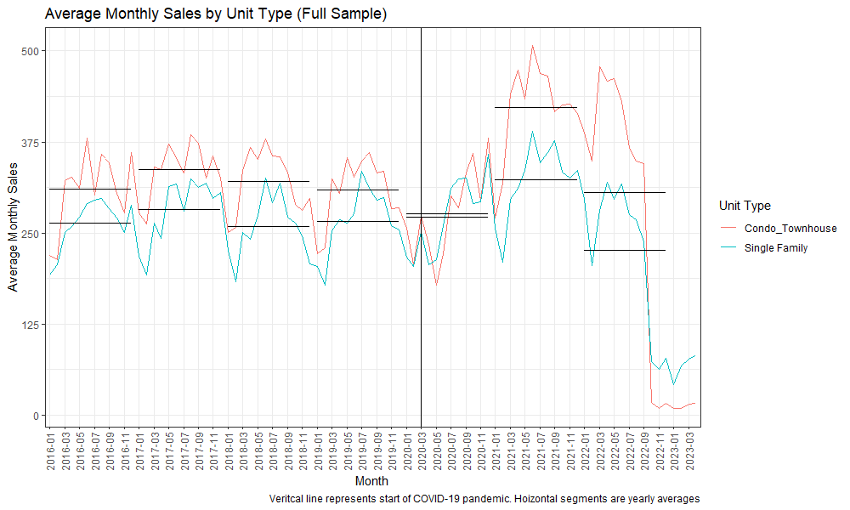
Data

Slide 8
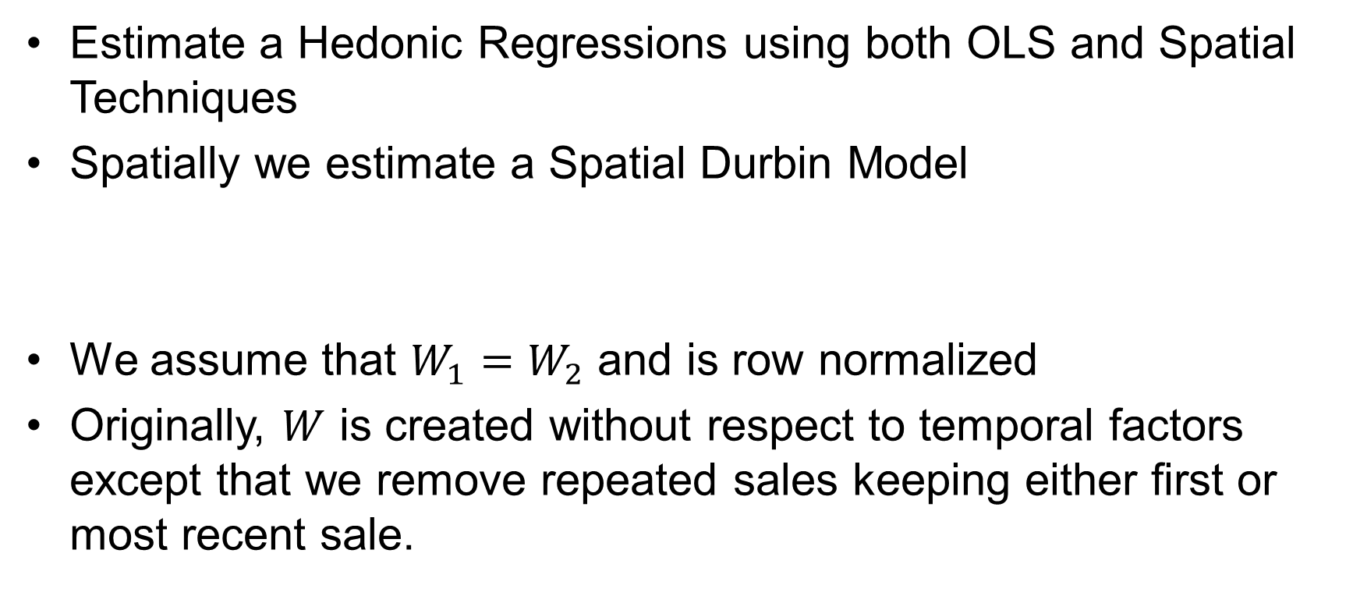
Methodology
Estimate a Hedonic Regressions using both OLS and Spatial Techniques
Spatially we estimate a Spatial Durbin Model
We assume that $W_{1}=W_{2}$ and is row normalized
Originally, $W$ is created without respect to temporal factors except that we remove repeated sales keeping either first or most recent sale.
$$\ln\left(P_{i}\right)=ρW_{1}P+β_{0}+{X_{i}β}_{1}+W_{2}Xθ+ε_{i}$$

Slide 9
Results

Slide 10
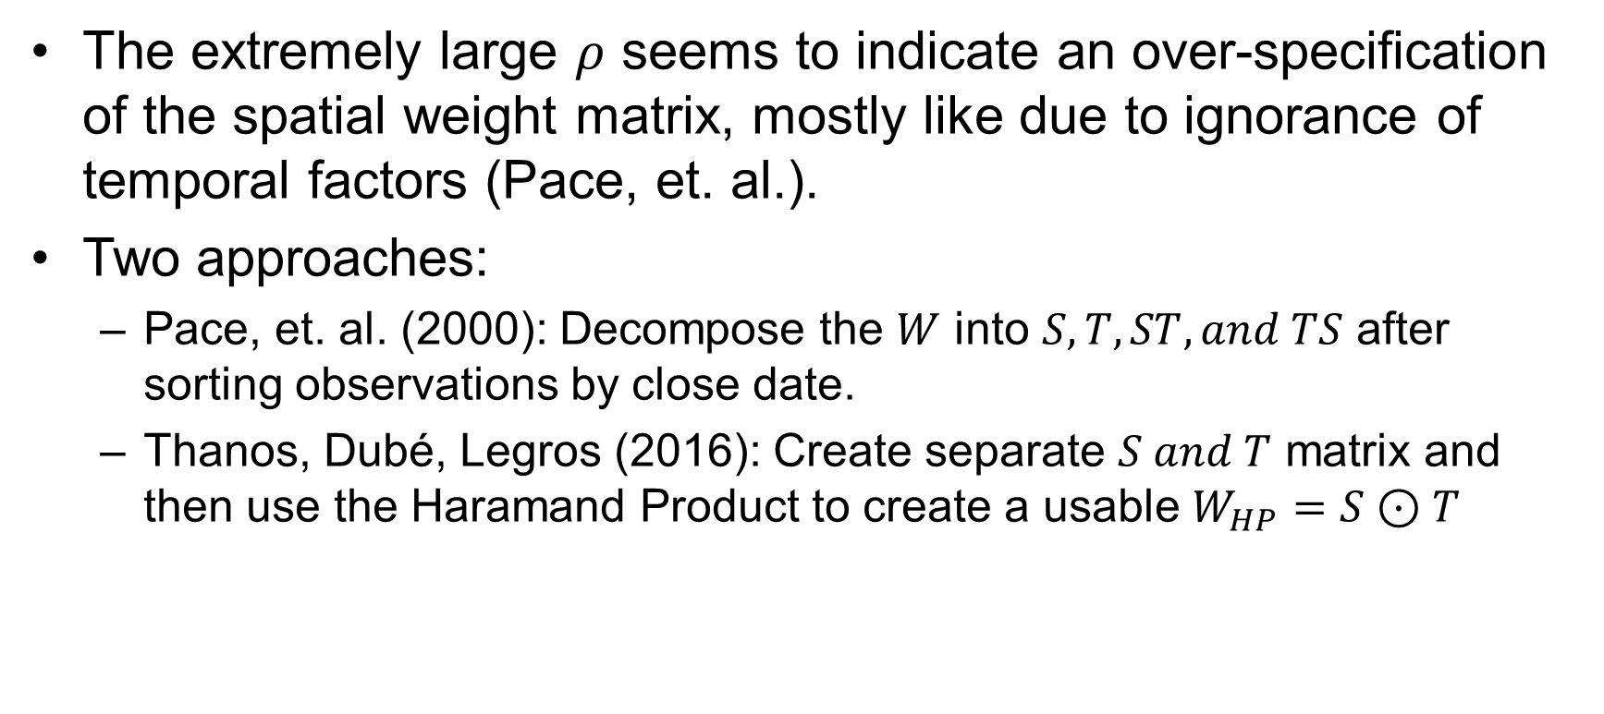
Methodology
The extremely large $ρ$ seems to indicate an over-specification of the spatial weight matrix, mostly like due to ignorance of temporal factors (Pace, et. al.).
Two approaches:
Pace, et. al. (2000): Decompose the $W$ into $S, T, ST, and TS$ after sorting observations by close date.
Thanos, Dubé, Legros (2016): Create separate $S and T$ matrix and then use the Haramand Product to create a usable $W_{HP}=S⊙T$

Slide 11
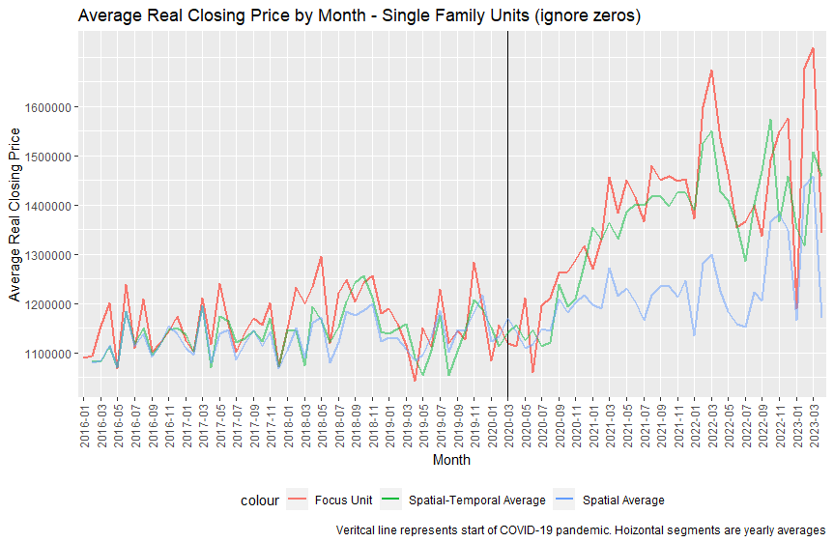
Visualizations

Slide 12
Results

Slide 13
Results

Slide 14
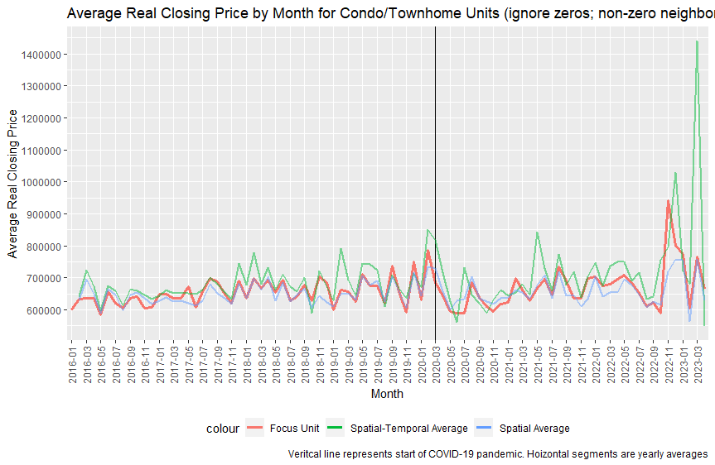
Visualizations

Slide 15
Results

Slide 16
Results

Slide 17
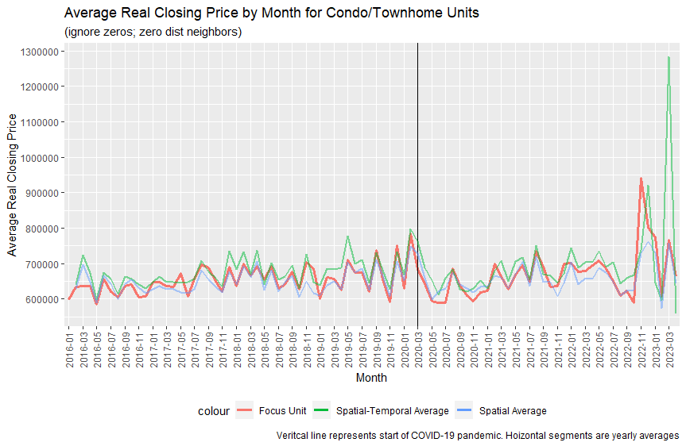
Visualizations

Slide 18
Results

Slide 19
Results

Slide 20
Conclusions
Single Family
The Pace, et.al. decomposition shows essentially zero COVID-19 impact among single family housing except a larger impact with the TS part – but what does this mean?
The Thanos, et.al. decomposition shows a clear direct impact from Covid-19 sales and, depending on when Covid-19 “ends” an indirect impact as well.
Condo/Townhome
The Pace, et.al. decomposition shows a significant positive spatial impact (S) that is larger within the same building, a significant negative impact (T) that is also slightly larger in the same building, no impact from ST and a very large positive impact from TS.
The Thanos, et.al. shows no statistically significant direct or indirect impact from a Covid-19 sale without regards to location (same or different building)

